Slide 1
Customizing Immersive Interactive Design
Dan Nydegger and Jeff Hanson
Southern Utah University

Slide 2

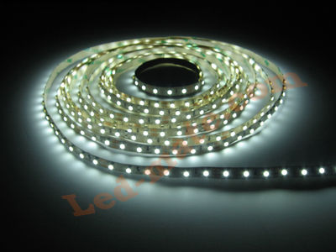
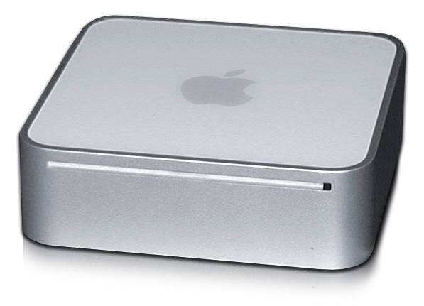
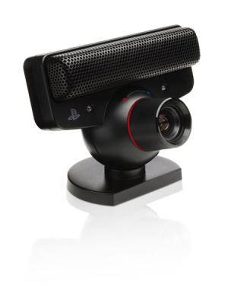
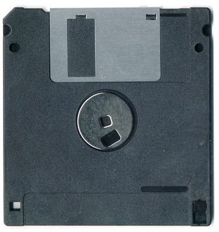

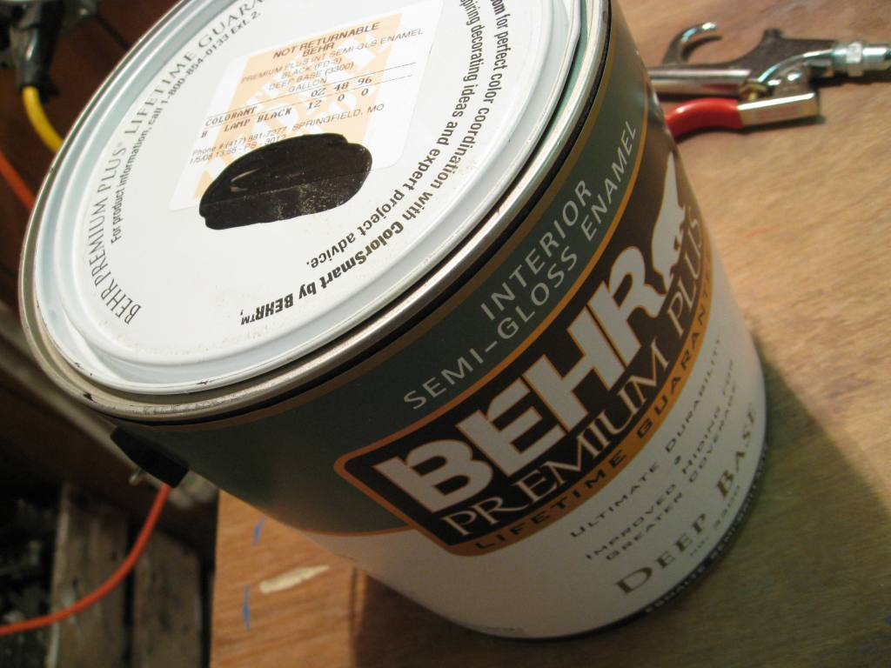
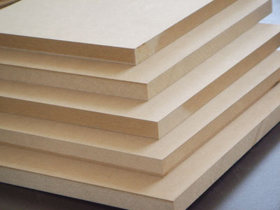

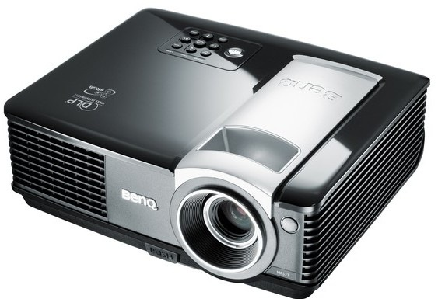

Slide 3
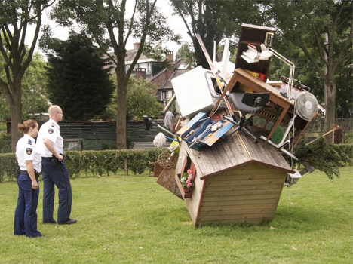

Slide 4
Touch Screen Table Display for
SUU Art and Design Student Portfolios

Slide 5
video

Slide 6
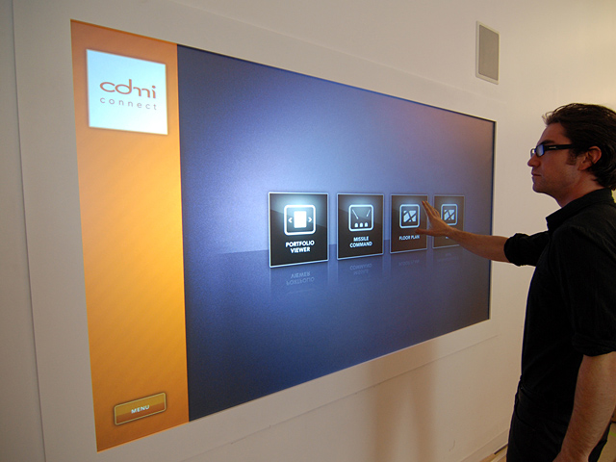
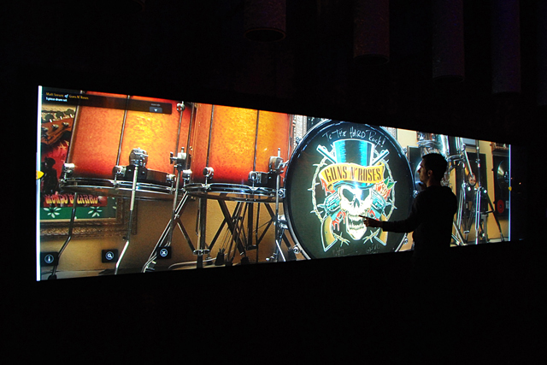
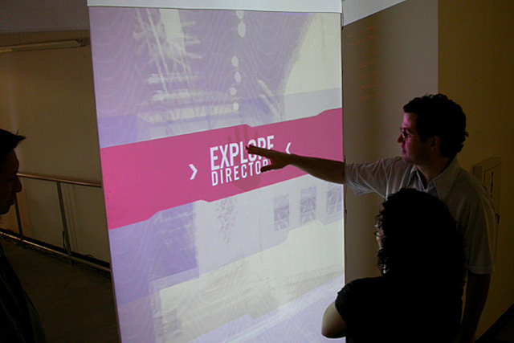
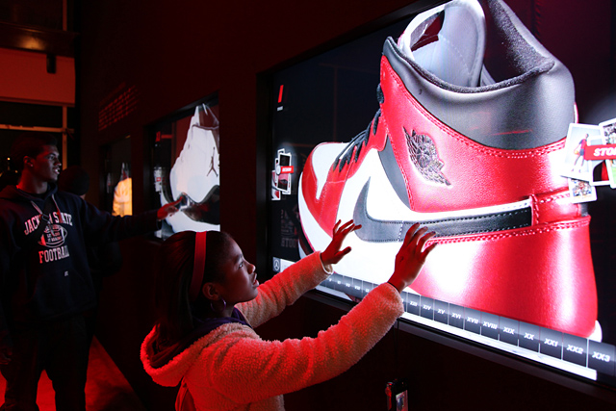
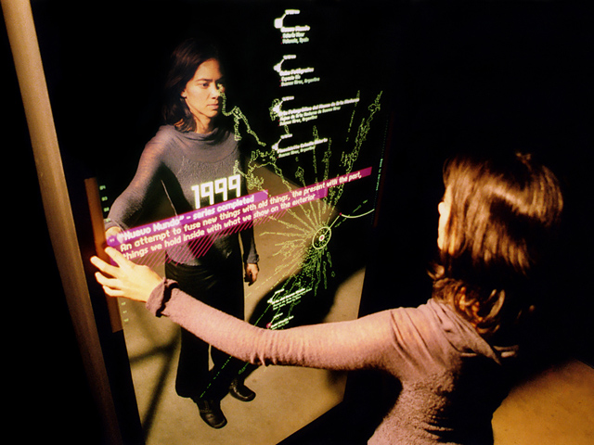
Nikolai Cornell, PUSH Offices

Slide 7
Hardware
PS3Eye Camera (modified for IR light)
24 in x 36 in acrylic sheet
Mylar sheet with silicon backing
10 ft of 850 nm Infra Red Lights
Projector
CPU

Slide 8
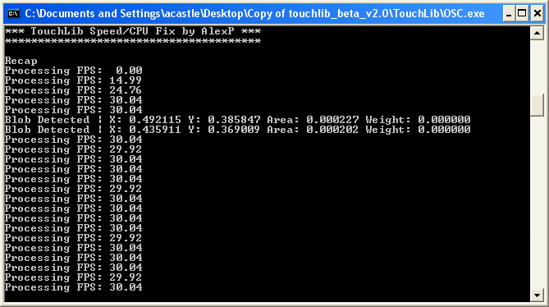
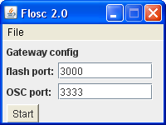
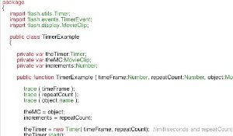
Software
Camera software
TUIO protocol
OSC (Open Sound Control)
FLOSC (Flash Open Sound Control)
Adobe Flash (Action Script 3
XML

Slide 9
Why?

Slide 10
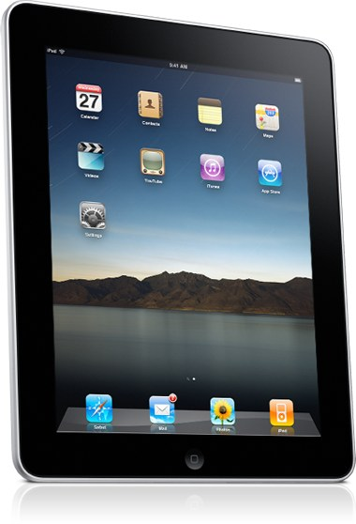

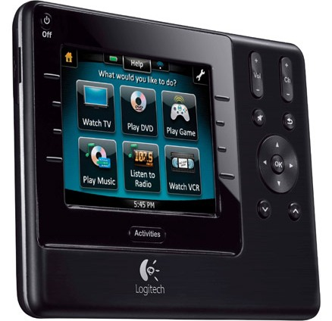
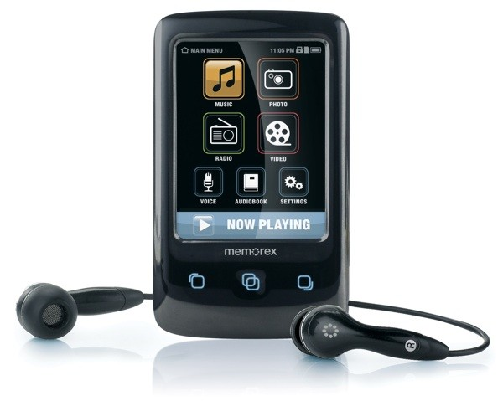
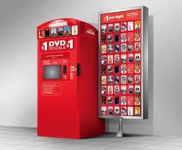
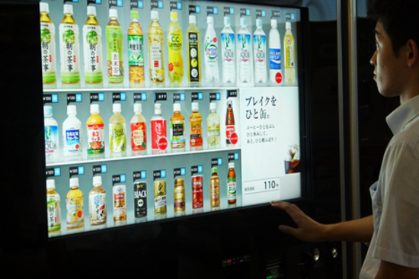
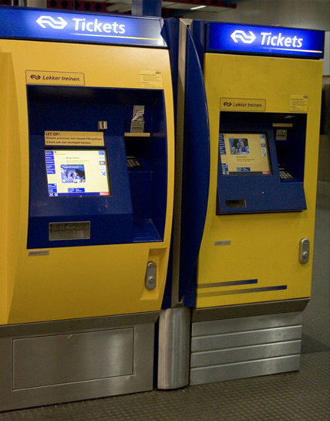
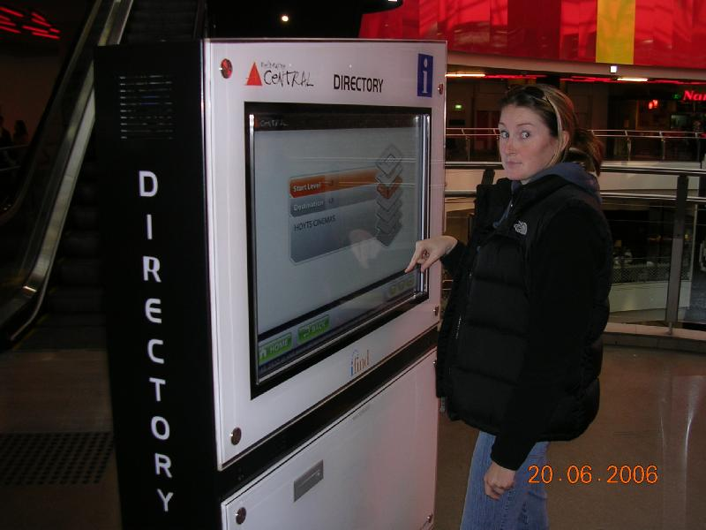

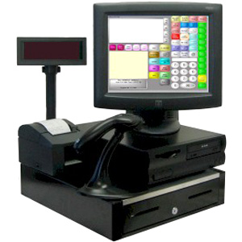
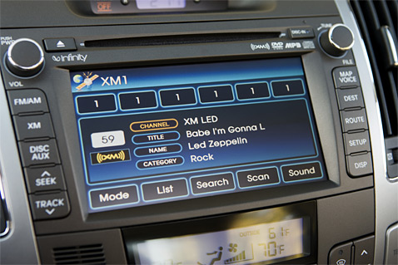
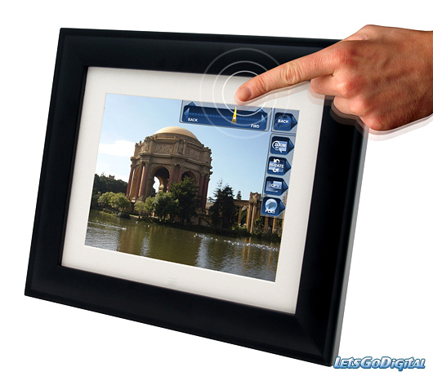

Slide 11
Touch technology is just an enabler, and ultimately, it is a compelling user experience — which includes good UI design, applications and services — that will make or break a product.”
C. Lu of Gartner Inc.

Slide 12
Graphic design is concerned with presentation of information.
Touch screens are becoming a staple method of how people get info.
Understanding technology leads to better design.
Allow for personal application of methods

Slide 13
Thank you
References
    Nicolai Cornell
    Maximum PC
    NUI Group
    TUIO Flash Blog
    Gartner Inc.
nydeggerdesign.blogspot.com
dan@dnyde.com

